Slide 1
Custom or COTS?
Software Engineering
Neil Toporski

Slide 2
1. Software Processes [Outline]
COTS
Software Specification
Software Design and Development
Software Validation
Software Evolution
Coping with Change
Prototype Development
Process Improvement

Slide 3
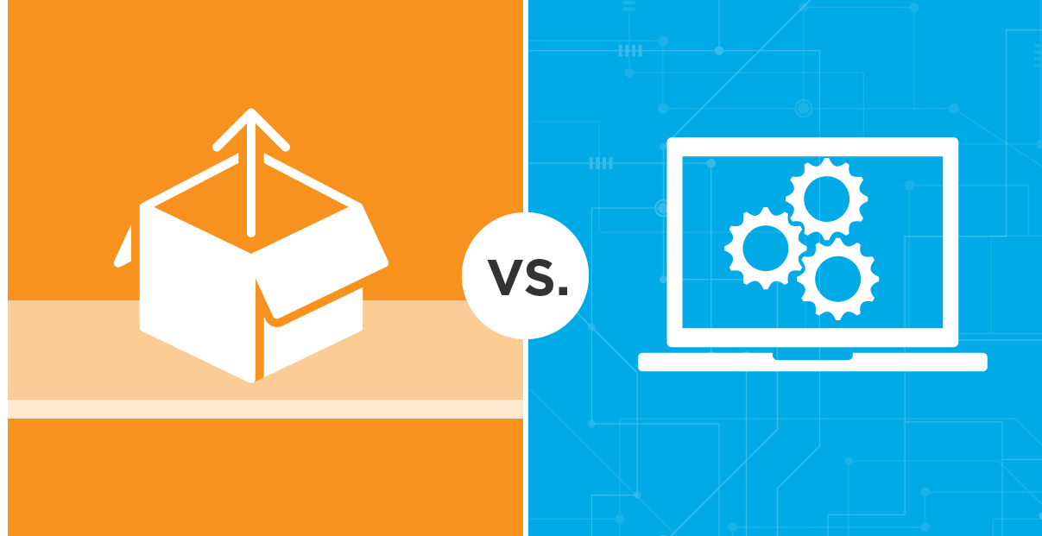
1.1 COTS: Build or Buy?
COTS solutions typically offer the benefit of lower initial investment and faster implementation.
The primary advantage of a custom solution is the ability to get exactly what you need, no more, no less.

Slide 4
1.1 Integration and Configuration: COTS
Reusability
Systems built using Commercial Off-The-Shelf (COTS) systems.
Reused elements may be configured to adapt their behavior and functionality to a user requirement.
Reuse not a standard approach to building may types of business systems.
Types of Reusable Software
Stand-alone applications (COTS).
Collections of packaged objects that are integrated into a framework such as .NET or J2EE.
Web services that are developed according to service standards.

Slide 5
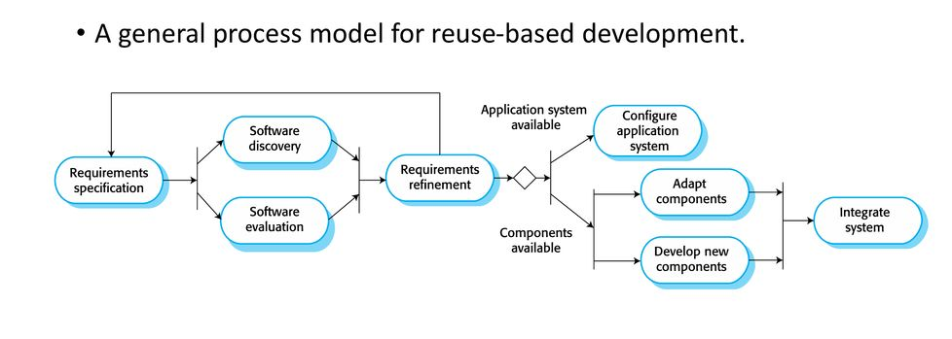
COTS: Integration and Configuration Development
Requirement specifications: what do you need?
Software discovery and evaluation: search for components, plug-ins and other options to meet requirements.
Application system configuration:
Configure COTS system.
Component adaptation
and integration:
customize components
using application API.

Slide 6
COTS: Integration and Configuration Development
Example: Knack database
Required:
relational database for Veuzz content
low or reasonable cost
Easy data entry
must be able to export to JSON (quickly)
Time!
Options:
build my own (e.g. mySQL)
COTS

Slide 7
Pros and Cons of Integration and Configuration Development
Advantages
Reduced costs and risks as less software developed from scratch.
Easily deployable.
Larger technical assistance.
Disadvantages
Requirement compromises are inevitable and may not meet the real needs of the client and users.
Loss of control over evolution (new versions) of reused system elements.
Licensing ,installation, and support costs.

Slide 8
Examples of COTS Software
Online databases: Zoho, Quickbase, Knack, Caspio…
Ecommerce: Shopify, WooCommerce, Ecwid…
Web analytic tools: Google Analytics, Baidu, HubSpot…
Geolocation: Google Maps, MapBox
Video Streaming, transcoding, and recording: Brightcove, Wowza, Panopto, Vimeo…
Visual Web CMS editors: Wix, Squarespace, Wordpress

Slide 9
1.2 Software Specification
The process of determining what services are required and the constraints on the system’s operation and development.
Requirements engineering process
Requirement elicitation and analysis.
What do the system stakeholders require or expect from the system?
Requirement specification
Defining the requirements in detail.
Requirement validation
Checking the validity of the requirements.
*Validation Plan document

Slide 10
1.3 Software Design and Development
The process of converting the system configuration into an executable system.
Software design: designing a structure (architecture) that adheres to the specification.
Development: Translate and build the software structure into an executable (viable) program.
Design and development may be inter-leaved.
Software creation
Programming
Debugging

Slide 11
1.4 Software Validation
Verification and Validation (V & V)
Validation: Does the system conform to its specifications and meet the requirements of the system customer? Are we building the right product?
Verification: Involves checking and reviewing processes. Are we building the product right?
System testing involves executing the system with test cases that are derived from the specification of the real data to be processed by the system
Notes:
Validation document -

Slide 12
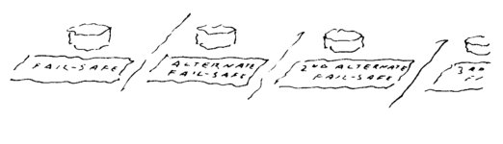
Is the System “Fail-Safe?” Software Reliability
When a fail-safe system fails, it fails by failing to be fail safe.

Slide 13
1.5 Software Evolution: Change Happens
Software changes.
System architectures change.
Business requirements change.
Companies evolve
Chapter 7
Company acquisitions
Macromedia Director, Flash, Pascal, Iomega, Netscape, AltaVista, Palm, Quibi…

Slide 14
1.6 Coping with Change
Systemantics: John Gall
New systems generate new problems.
Peanut butter sandwiches fall peanut butter side down.
Complicated systems produce unexpected outcomes.
The real world is whatever is reported to the system.
If a system is working, leave it alone.
If a complex system designed from scratch never works and cannot be made to work – you have to start over, beginning with a working simple system.
Notes:
Upkeep and maintain, become bigger
It can go wrong, things happen
E
System only knows what you feed it
E
Start simple

Slide 15
Coping with Change
Change is inevitable

Slide 16
Reducing the Cost of Rework
Anticipate changes. Prototype systems can be developed to show key features to clients.
Change tolerance. The process accommodates changes at relatively low costs.
This normally involves some form of incremental development.

Slide 17
1.7 Prototype Development
a prototype is a rudimentary working model of a product or information system, usually built for demonstration purposes or as part of the development process.
Usually to test or evaluate a small “snippit” of the project.
Focuses on areas of the product not understood.
Anticipate changes.
May cause “spike” in Burn Up Chart (TBA)
Used mostly for demonstration and review by the client.
Prototypes should be discarded after development.
They are not normally documented
Rarely meet quality standards of development

Slide 18
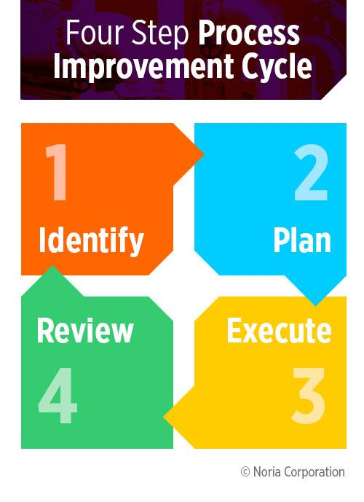
1.8 Process Improvement
Understanding existing processes and changing these processes to increase product quality, reduce costs, or reduce development time.
Agile approach: An iterative approach for rapid delivery of functionality and responsiveness (and quality) to client requirements.

